Slide 1
MovieFlix OTT Platform
Raj Jain (21004500210051)
Monil Jain (21004500210050)
Parth Bhayani (21004500210018)

Slide 2
Introduction
An movieflix ott platform is a platform which shows the movies & series digitally through internet in mobiles,laptop etc.
A streaming service that allows our members to watch TV shows and movies on internet connected devices.

Slide 3
Objectives
1. Content Delivery and Accessibility : Ensuring that content is accessible across various devices, including smartphones, tablets, smart TVs, and computers, is a core objective.
2. Content Protection and Legal Compliance : OTT platforms must ensure they comply with legal and regulatory
3. Content Creation and Acquisition: OTT platforms focus on producing exclusive original content that cannot be found elsewhere, driving subscriptions and viewer loyalty.

Slide 4
Objectives
4. User Experience and Engagement: OTT platforms focus on delivering a seamless, intuitive, and personalized user experience.
5. Data Utilization and Personalization: OTT platforms use data analytics to understand user preferences and behaviors, offering personalized content recommendations and targeted marketing.

Slide 5
Project Profile
Project Name | MovieFlix OTT Platform
Developed by | Raj Jain, Monil Jain, Parth Bhayani
Front-end | HTML 5, tailwind CSS 4, JavaScript, React.js
Back-end | Node.js, MongoDB, Express.js, Movie db
Tools | Visual Studio Code 1.8

Slide 6
Targeted users
Admin
Users

Slide 7
Project Definition
An MovieFlix OTT platform involves outlining the core aspects of the project, including objectives, scope, target audience, features, technology stack, and timeline.

Slide 8
Assumption
There is a continuous increase in consumer preference for on-demand streaming services over traditional TV.
Users have access to high-speed internet, which supports HD and UHD streaming.
Users will set realistic budget limits and track expenses carefully to avoid overspending.
The platform will be designed to scale with increasing user demand and content volume.

Slide 9
Constraints
Ensuring the platform can handle growing numbers of users and content without performance degradation.
Frequent updates and changes in device firmware or operating systems can affect compatibility.

Slide 10
Advantages
Anytime, Anywhere Access: OTT platforms allow users to watch content on-demand, whenever and wherever they want, as long as they have an internet connection. This flexibility is a significant advantage over traditional media.
Multi-Device Compatibility: Content can be accessed across various devices, including smartphones, tablets, smart TVs, gaming consoles, and computers, making it easy for users to watch on their preferred screen.
Customizable Viewing Experience: Users can create profiles, set preferences, and enjoy features like subtitles, multiple language options, and adjustable playback settings.

Slide 11
Limitations
Buffering and Latency: Users may experience buffering or latency issues depending on their network conditions and the platform’s content delivery infrastructure.
Geo-blocking: Users may face restrictions based on their geographic location, which can limit access to certain content.
Constant Innovation: The need to continually innovate and offer new features to stay competitive can strain resources.

Slide 12
Requirement Determination
User Needs: Identify what features users need, like guest registration, budget tracking, and communication tools, to ensure the system meets their requirements.
Security Needs: Determine the level of data security required to protect sensitive information, such as personal details and payment data.

Slide 13
Screenshot’s

Slide 14
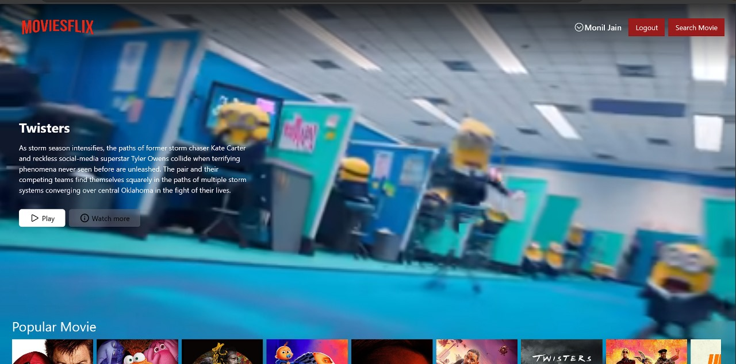
Home page:

Slide 15
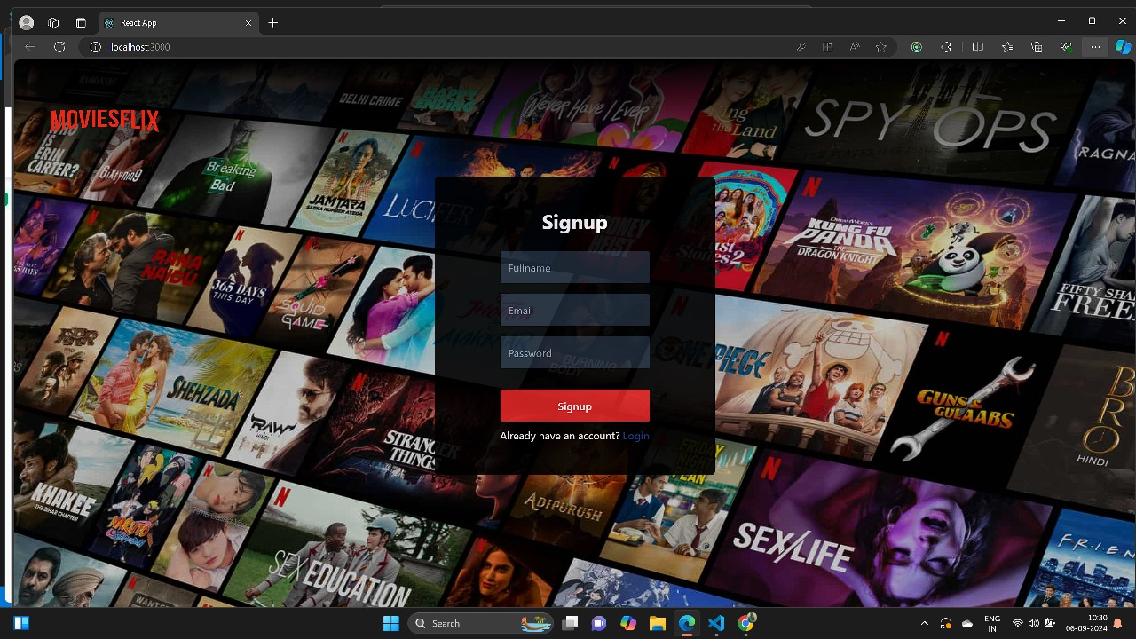
Register Page:

Slide 16
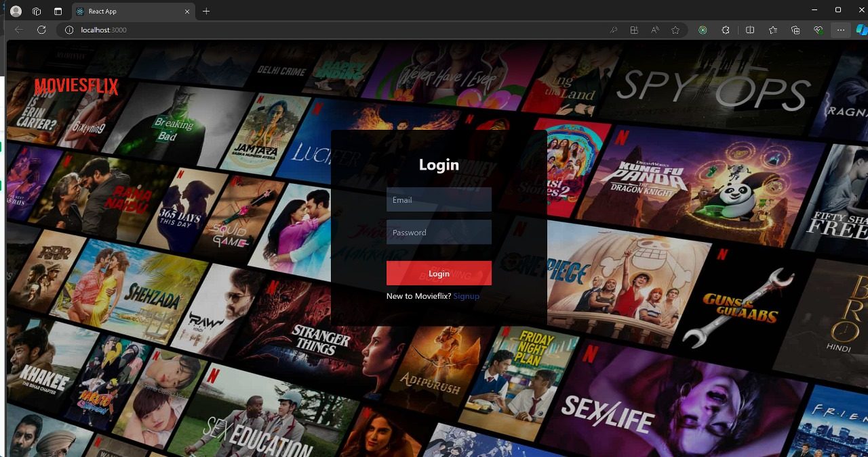
Login Page

Slide 17
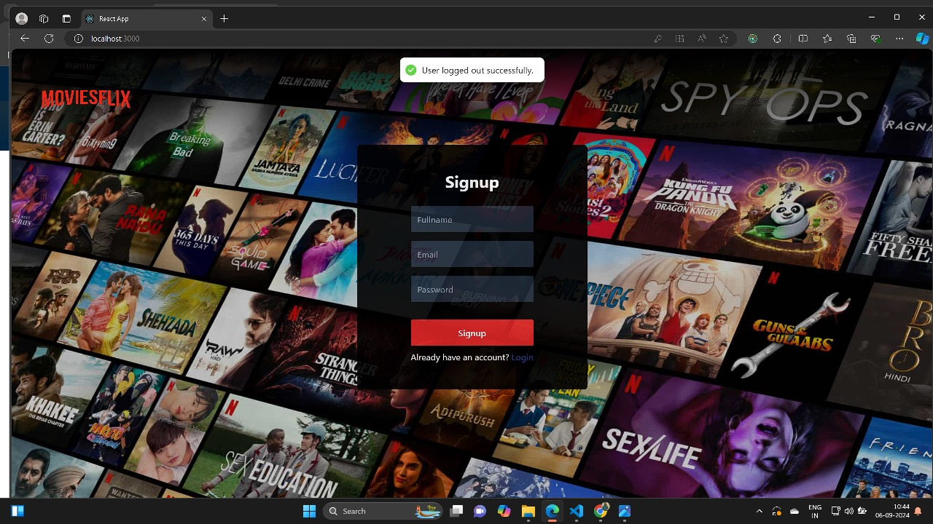
Log Out

Slide 18
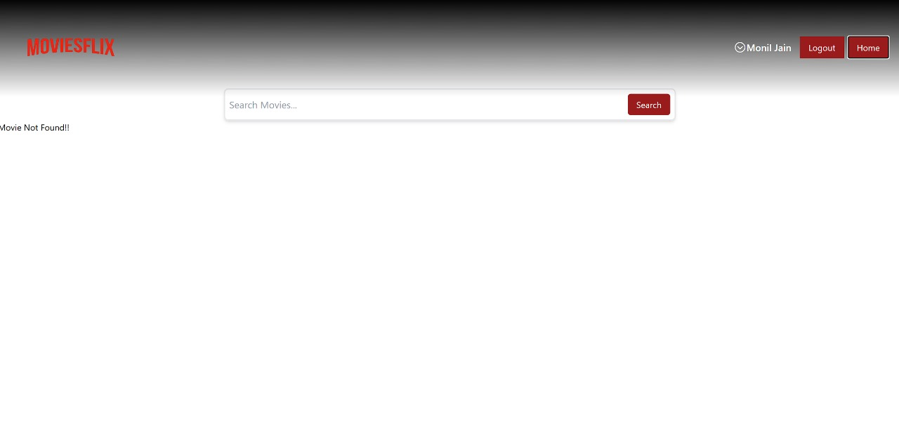
Search movies

Slide 19
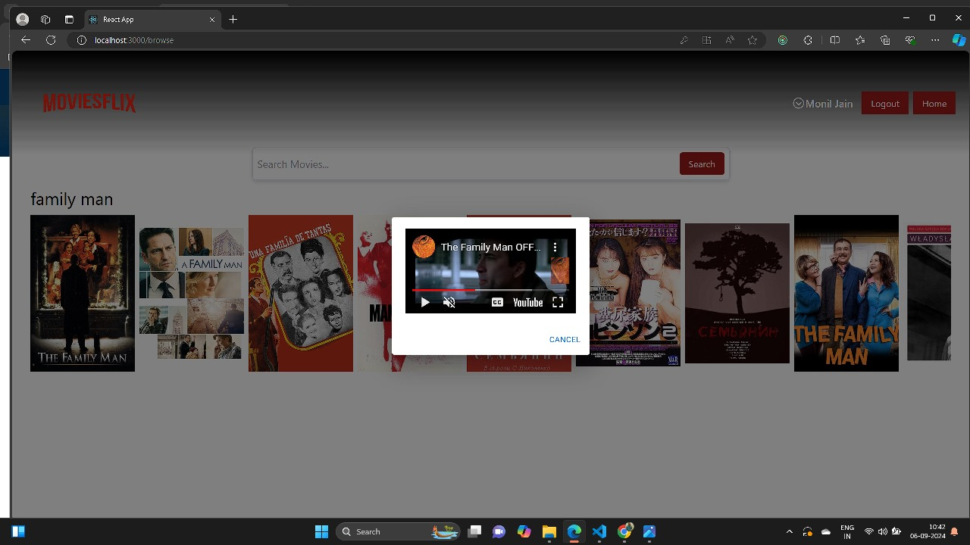
Movie found:

Slide 20
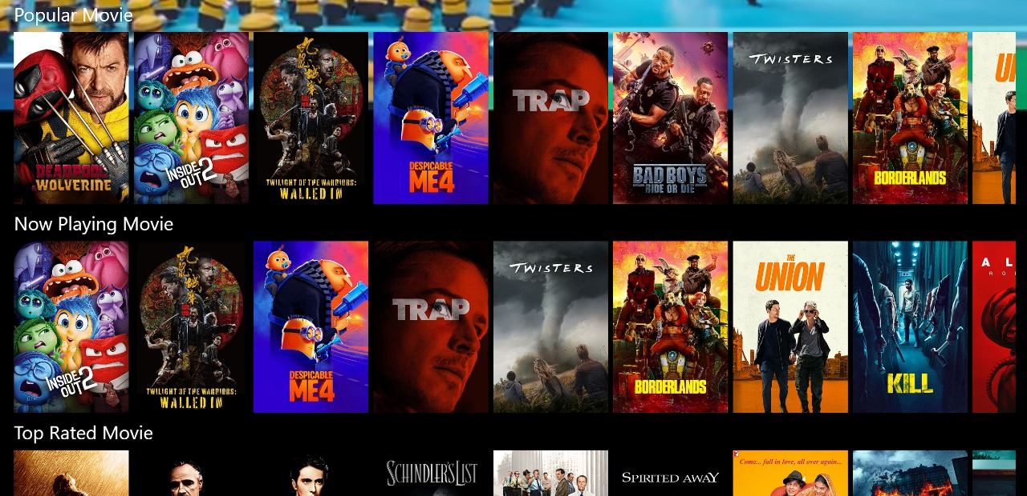
All movies:

Slide 21
Thank You

